Slide 1
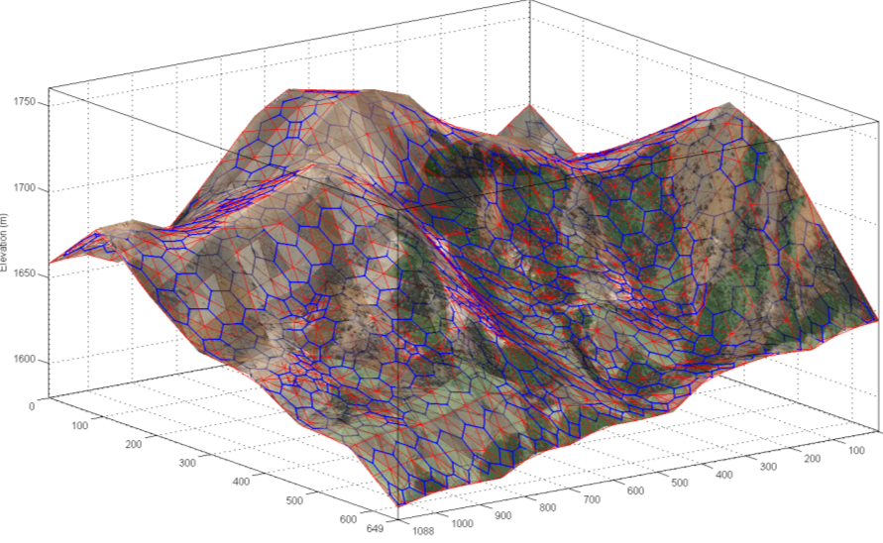
SSES
Sensor Suite Evaluation System
Project Presentation
8 May 2009
Helen Anderson, Steven Beres, Joseph Shaw, Tim Valadez
Sponsor: Professor K. C. Chang
Faculty Advisor: Professor Thomas Speller

Slide 2
Project context:
Team: Helen Anderson, Steve Beres, Joe Shaw, Tim Valadez
Role: The team is acting as a product development team for a Sensor Suite Evaluation System (SSES) that will improve of the design of electronic security systems (ESS) used to detect intrusion into a defended site
Terms of Reference:
  ESS: Set of exterior sensors of various types selected and positioned to detect intrusion into a specific site – what we are trying to design and sell to the customer
  SSES: Software based design and assessment tool that supports and enhances the ESS design process by facilitating site characterization and the selection, placement, and evaluation of sensor suites – what we are trying to build to improve our ESS designs and license to other ESS designers
Notes:
Good Afternoon everyone. We are the Sensor Suite Evaluation System development team. My name is Helen Anderson, I am an Operations Research major. These are my team mates … (everyone else introduce themselves)
The role of the SSES development team is to improve the current Electronic Security System or ESS selection methodology. The intent of the SSES is to become a new cost effective sensor suite platform with emphasis on a graphical user interface (GUI), probability of detection, and sensor specifications. The goal of the SSES is to develop a system to assist users of ESS in the set-up of their systems to achieve a complete and reliable surveillance using the most cost effective means available.
There are two terms we will refer to continuously through the presentation. ESS and SSES.

Slide 3
ESS Business Process Flow
Proposal
Phase
Initial customer engagement
Detailed site survey
Desired process flow
Design
Phase
Detailed ESS design
Sensor selection
Sensor placement
Sensor integration
Implementation Phase
Suboptimal process flow
Determine customer needs / budget
Preliminary site survey
Procure ESS hardware / software
ESS cost assessment
ESS performance modeling
Preliminary ESS design
Accept design contract
Revise proposal
Redesign ESS
Perform site prep
Meets requirements?
Yes
Preliminary ESS cost estimate
Exercise implementation option
Install ESS
No
No
Design space exhausted?
Generate proposal
Test ESS performance
Yes
Customer accepts design
Customer response
Relax budget / requirements?
No
Meets performance spec?
No
Failed proposal
Failed design
Failed system
Successful system
Notes:
This slide shows the process for delivering an ESS to a customer today.
The process starts with initial engagement with the customer to determine their security system needs and budget.
A preliminary survey of the customer site is conducted and used to produce a preliminary ESS design which provides the basis for a design-build proposal.
If the proposal is successful the team performs a detailed site survey and detailed ESS design, and assesses ESS cost and performance against customer requirements. ESS design may proceed through several iterations before converging on a successful design.
Proposal generation is a net cost, and site design is a low margin process. The major source of profit is actually landing the contract to procure and install the ESS.
The current ESS design process is manual and ad hoc. Significant effort is required to conduct the site surveys and perform ESS design. There are many opportunities for error and resulting designs are often sub-optimal. Gaps in coverage are a particular source of concern.
The objective of the SSES is to automate and support portions of the design process (highlighted in green) in order to improve the productivity and performance of the design team, and the quality of the resulting ESS designs.

Slide 4
Problem Statement:
There is currently no effective methodology for systematically selecting the best Electronic Security System (ESS) design for detecting and communicating an intrusion of sensitive facilities.
In many cases, the placement, type, and quantity of selected sensory is set-up in an ineffective or inefficient configuration, resulting in gaps in surveillance ability and/or unnecessary costs.
Notes:
Currently an effective way to determine the proper placement, type, and quantity of the selected sensory does not exist. To determine sensor placement, perimeter security personnel must actively determine sensor placement by being on-site and extensive testing must be done to ensure the sensor placements will provide adequate security. A system is needed that is more cost effective and is able to achieve a complete and reliable surveillance. A system needs to be designed to give results for a wide variety of terrain types and site locations. Because intruders are difficult to detect without electronic sensors no site perimeter can be considered totally secure. This creates a need to identify intruders to allow significant time for first responders to secure the site perimeter. The purpose of the SSES is to fill the current capability gap of the current ESS selection process. The focus of the SSES is to provide a GUI system at a relatively low cost.

Slide 5



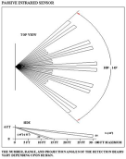

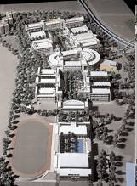

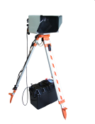







$
P_{d}
FAR
Internet
Notes:
The OV-1 Diagram is the high level operational document associated with DoDAF products.
The intent of the system (moving clockwise from the upper left corner) is to process imagery of a site. This can come from satellite data, 3-D rendering, architectural drawings, etc.
The system will also process weather data be cause the environmental conditions impact the performance of the sensors.
The sensor specifications and performance data is also processed. This data can include Pd and FAR data, power requirements, networking requirements, and sensor operational data because the type of sensor determines the impact of the environmental conditions.
Threat data is also processed, in that the security of a site is dependent on the types of threats the site is protecting against.
Physical barriers and obstructions are also processed because these impact the “Deterrence” component of site protection.
The system should be able to access data from the internet. This can include weather, threat, and environmental data.
The system should also be able to access/be accessed by specific databases well. This can include private/secure networks and customer databases.

Slide 6
Project Development
Process
SSES
Step 1
Develop Problem Statement
ID/Communicate with Stakeholders
Identify Needs/Wants
Conduct Technical Studies
Determine Scope/Schedule
Establish Milestones
Analysis
Step 3
Requirements
Develop Form/Function Alternatives
Comparative Analysis
Develop Preferred Alternative
Develop Intent Specification
Develop T&E Strategy
Step 2
Develop Requirements Documents
Develop Use Cases
Develop Functional Decomposition
Identify Alternatives
Design
Step 5
Implementation
Implement T&E Strategy
Step 4
Develop Business Plan
Conduct Market Survey
Competitive Analysis
Develop Prototype
Testing/
Integration
Step 6
Develop Technical Proposal
Develop Technical Paper
Proof of Concept Prototype
Delivery
Notes:
This is not the traditional waterfall approach since is incorporates feedback from one step to another based on the stakeholder validation and development team testing.
This model is closer to a rapid prototype model or a incremental model. The rapid prototype model is mainly utilized to develop requirement specifications for proof of concepts (which is really what we are doing), and the incremental model focuses on developing the product in manageable increments. We are doing both in this class because of the short time available to develop the system and the need to scope the system into manageable components.
The main components we will cover in this presentation are:
Develop problem statement (step 1)- already covered
The stakeholder analysis, value identification (step1)
Functional decomposition, from/functions (Step 2 and 3)
Business plan, market survey (Sept 4)
Prototype demonstration / test case (Step 6)
6

Slide 7
Stakeholder Assessment
Environmental
Protection
Zoning and
Regulatory
Neighbors
Enemy
Adversaries/
Intruders
Law
Enforcement/
Military
Government
Community
Collateral
Participants
Software
Designers/
Vendors
SEOR
Faculty
Site Users
Suppliers
Management
Legal/PR
Sensor
Designers/
Manufacturers/
Vendors
Customer
Network
Designers/
Manufacturers/
Vendors
ESS
Operators
Security
Forces/
First
Responders
Competitors
Established/
Incumbent
SSES
Potential
New Entrants
External
SSES
Internal
Contracts
SSES
Maintenance
and Support
Legal/PR
Other
Company
ESS/SSES
Team
SSES
Installation
Team
ESS Site
Assessors
Management
SSES
Development
Team
Sales
Notes:
During the course of our project, we did a stakeholder assessment. The team identified the stakeholders by creating stakeholder categories and filling those categories with individual stakeholders based on their benefits/interest areas, priorities, and behaviors.
We have two overall categories of Stakeholders, Internal and External. Within those two categories the team created additional Stakeholder categories. These categories contain the actual stakeholders. Included in the SSES Stakeholders are the SSES development team, the SEOR faculty, the Customer, Suppliers, and Enemy.

Slide 8
Stakeholder Assessment
Management
Sec System Operators
Adversaries
Management
SSES Development Team
Notes:
After identifying our stakeholders the team created a Stakeholder Value Mapping. Using this mapping the team was able to assign each Stakeholder an overall score. This bar chart shows each stakeholder’s score. We decided to focus on the stakeholders with scores between 0.85 and 1.1 as shown by the beige rectangle. A total of six Stakeholders fell into this range. Management for both the internal and external stakeholders, security system operators/monitors, adversaries/hostile-intruders, and of course the SSES development team.

Slide 9
SSES p-Diagram
Uncontrollables
Weather
Threats
Budget
Noise/Error
Modeling Limitations
Inputs
Outputs
Stakeholder Objectives
Terrain
Site Design
Sensor Specifications
Security Requirements
Sensor Suite Evaluation System (SSES)
Cost Estimate
ESS Site Design
Security Assessment
Gaps in Coverage
Controllables
Sensor Selection
Sensor Placement
Sensor Schema
Sensor Quantity
System Operation/Processing
Add-on functionality
Notes:
The Parameter Diagram (p-Diagram) of the SSES illustrates the inputs to the outputs of the system. It is used to help determine the objective of the system.
The main items to observe are the inputs and the outputs. The
We also identified the controllable and non-controllable factors that affect the performance of the system.
Weather:
Threat: The threats are uncontrollable in that the system can only represent known threats. Like any scurity system, the threat model is based on threat assessments and the threats are continuously trying to overcome the security system.
Budget:

Slide 10
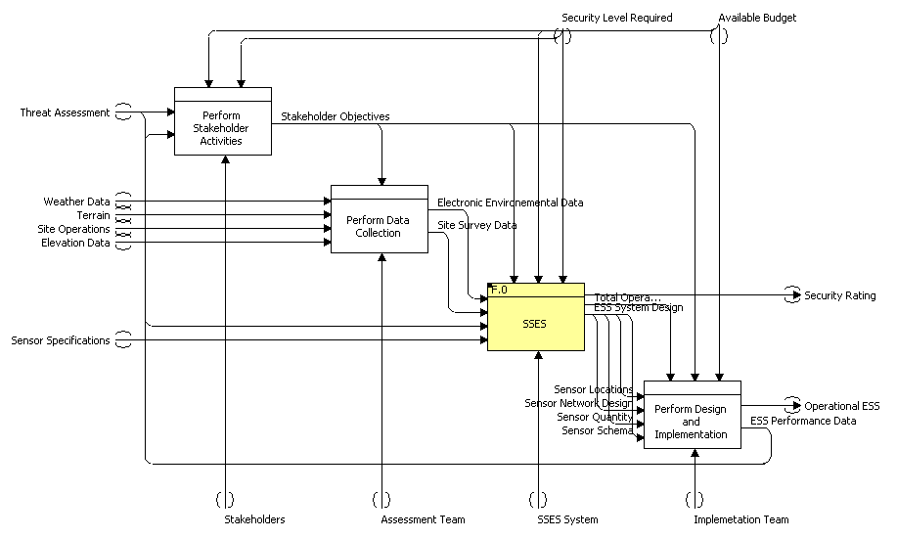
SSES: IDEF A-1 External Systems Diagram

Slide 11
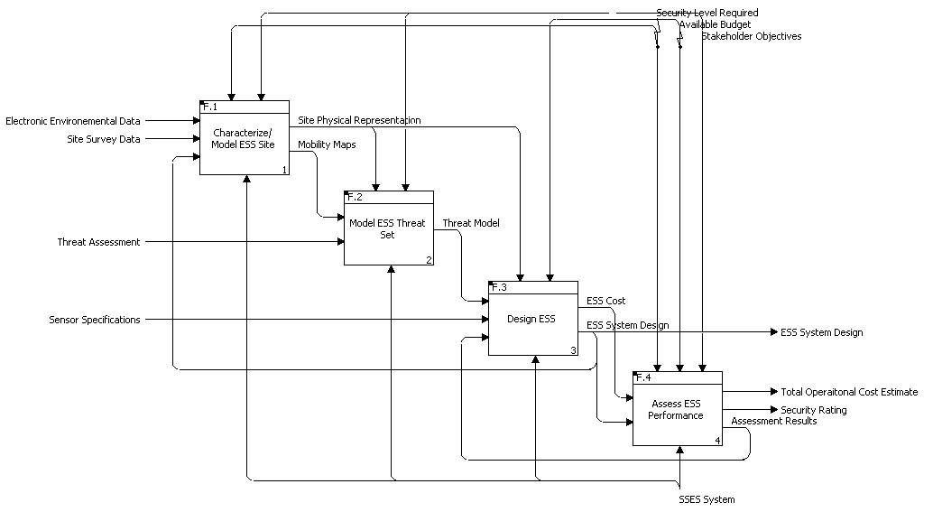
SSES A0

Slide 12
SSES Functional Decomposition
Design & Assess ESS
1 Assess and represent site characteristics
2 Assess and represent threat characteristics
3 Develop ESS designs and assess technical performance
4 Assess ESS operational performance
1.1 Get and use site attribute data
1.2 Construct site model
2.1 Classify threats by type & attributes
3.1 Represent single sensor performance
3.2 Model emplaced single sensors
3.3 Model multi-sensor networks
4.1 Analyze
operational performance
1.2.1 Construct terrain type map
2.2 Manage signature data
3.1.1 Maintain sensor database
3.2.1 Select sensors
3.3.1 Construct sensor networks
4.1.1 Route specific MOE
1.1.1 Get/display/ use terrain and feature data
2.2.1 Threat type & number
3.1.2 Represent sensor P_{d}
3.2.1.1 Manual selection
3.3.1.1 Manual selection
4.1.1.1 Min ingress / egress time
1.2.1.1 Partition by terrain type
2.2.2 EO/IR signature
3.1.3 Represent sensor range
3.2.1.2 Semi-auto selection
3.3.1.2 Heuristic selection
1.1.1
Terrain types
4.1.1.2 Minimum P_{d}
2.2.3 Radar signature
3.1.4 Represent false alarm rate
3.2.1.3 Auto-matic selection
3.3.1.3 Form networks
4.1.1.3 Minimum reaction time
1.1.1.2
Topographic data
1.2.2 Construct elevation model
3.1.5 Environ-mental effects
2.2.4 RF signature
3.2.2 Place / orient sensors
3.3.2 Assess coverage, performance, cost
4.1.2 Assess vulnerability
1.1.1.3 Feature data
1.2.3 Construct mobility model
2.2.5 Acoustic signature
3.1.6 Represent sensor FOV
3.2.2.1 Manual selection
3.1.7 Represent scan/revisit times
3.3.2.1 Sensor architectures
4.1.2.1 Perimeter P_{d} & P_{interdict}
1.1.1.4 Elevation data
1.2.3.1 Move rates and dwell times
2.3 Support sensor models
3.2.2.2 Semi-auto selection
3.3.2.2 Apply sensor fusion
1.1.1.5 Imagery
3.1.8 Support requirements
4.1.2.2 Worst case area P_{d}
1.2.3.2 ID Ingress/egress routes
2.4 Manage threat mobility data
3.2.3 Model sensor coverage and P_{d}
3.3.2.3 Determine point P_{d}
4.1.2.3 Worst case P_{keep-out}
1.1.2 Get/display/use environment data
2.4.1 Speed over terrain
3.1.9 Estimate single sensor cost
3.2.3.1 Model detection
3.3.2.4 Determine area P_{d}
4.1.3 Display vulnerability
2.4.2 Prohib-ited terrain
3.4 Estimate Sensor Network Cost
3.2.3.1.1 Calculate LOS
3.3.2.5 Determine network FAR
1.1.2.1 Weather
1.2.4 Manage site models & data
4.1.3.1 Max vulnerability routes
2.4.3 Barriers & obstacles
3.4.1 Installed + infrastructure costs
3.2.3.1.2 Propagation loss
3.3.3 Show coverage, & form.
1.1.2.2 EM/RF interference
3.2.3.1.3 Field of view
4.1.3.2 Min response time routes
1.1.2.3 Traffic
Level
2.5 Represent threat objectives
3.3.3.1Point-to-point P_{d}
3.5 Optimize ESS designs
3.2.3.1.4 Terrain type
4.1.3.3 Cumulative P_{d} coverage
1.1.2.4 Manage environ. data
0
2.5.1 Intrusion objectives
3.2.3.1.5 Environment
3.3.3.2 Area P_{d}
1
2.5.2 Covertness posture
3.5.1 Manage designs and MOE/MOP
3.3.3.3 Coverage by sensor type
4.2 Estimate ESS total cost
2
3.2.3.1.6 P_{d} at discrete points
3
2.5.3 Survivability objectives
3.5.2 Manually iterate designs
3.2.3.1.7 Area aggregate P_{d}
3.3.3.4 Gaps and blind spots
4.2.1 Procure,
install, operate cost
4
3.5.3 Heuristically iterate designs
3.3.3.5 False alarm rate
5
2.6 Support route planning models
3.2.3.1.8 False alarm rate
Notes:
To determine required capabilities of the SSES (functions) and ways of providing the capabilities (forms) we started by conducting a detailed functional decomposition.
Overall goal is to support design of the ESS
< click >
This requires us to 1) assess and represent the site, 2) assess and represent the threat including his likely objectives, 3) develop ESS designs and assess the performance of individual ESS elements, and 4) assess the overall operational performance of the ESS, i.e. the ability of the ESS to prevent an intruder from penetrating the site without being detected.
<click>
For the site we need to first get site data and then construct appropriate site models that can support the design process – this is one of the most time consuming parts of the current process.
For the threat we need to characterize the threat, identify detectable signatures and get this signature information to sensor models, and identify threat objectives and likely ingress and egress routes.
For ESS design we must first represent the nominal performance of individual sensor elements, then assess their likely performance when used in specific applications and locations. Since ESS typically use multiple sensors we need to assess the combined performance of the full suite of sensors. An iterative design process is used to optimize ESS design.
Finally we need to assess the overall operational performance and cost of the proposed ESS system.
<click>
Most of these functions was decomposed further. I will not try to go through every block. The full functional decomposition is available on the SSES website. The SSES prototype is focused on:
Terrain types and site topography
Threat mobility considerations - including the effect of barriers – and ingress / egress routes
Sensor performance, selection, and placement, including the effects of field-of-view and line-of-site on effective sensor coverage
Assessment and display of operational performance including multiple sensor coverage, and detection and display of coverage gaps and vulnerabilities.
<click><click>
The functional decomposition provided the basis for drafting a functional requirements document, and performing a solution space evaluation and down-select – both of which are documented on the website.

Slide 13
BUSINESS CASE
Notes:
Good afternoon. I’m Tim Valadez, and I will present the business case of the SSES. First, I’ll present our initial marketing strategy. Then I’ll follow with a cash flow analysis and finish with a net present value analysis before handing the brief back over to Joe for a quick demonstration.

Slide 14
Marketing Introduction Strategy
No other computer software package exists to provide these capabilities.
PHASE 1 (3 Years) – Military base camps, small military installations worldwide, and small government facilities.
PHASE 2 (3 Years) – Sensitive utility sites such as water treatment facilities, electricity relay stations, nuclear reactors, airports, seaports, and other critical infrastructure as identified by DHS
PHASE 3 (4 Years) – Private and commercial customers
Notes:
[SLIDE 1] Marketing Introduction Strategy
Currently, there appears to be no existing computer software package that can assist customers seeking to install or improve an intrusion detection system and thus compete with the SSES directly. Our closest competition is the status quo of a security expert conducting a site visit and designing the system manually.
Our initial marketing strategy will occur in 3 phases. Our first targeted customers for this product are small military installations worldwide, and small government facilities. This specialized market segment offers a low-risk opportunity for the SSES to be introduced while continuing to be refined for wider market expansion. Future markets will focus on sensitive utility sites such as water treatment facilities, electricity relay stations, nuclear reactors, airports, seaports, and other critical infrastructure as identified by Department of Homeland Security and local law enforcement agencies. As our governmental customers gain an appreciation for a more efficient security system, and its associated lower overhead costs, we will begin to lobby Congress for an increased presence throughout all governmental agencies. Complete market penetration will include private and commercial customers.
Customers who purchase the SSES will receive a renewable license to operate the SSES software, access to all future software updates, and initial software training. Our first customers will also receive an initial site survey by SSES staff.
The strategy of offering the SSES in this fashion is the result of several considerations. First, the intensive customer-service oriented approach will build an early reputation that will translate to higher growth rates in future years. Second, given the unique nature of the program, an untrained novice could misuse it with less than optimal results and unnecessarily harm the reputation of the SSES. Finally, by limiting the license to a relatively small number of users, we increase the chances for larger agencies to give the SSES repeat business. The option of selling an unlimited license at higher cost, but with only limited customer support was considered, but rejected as being too high risk, since an early failure could devastate sales growth, which is key to future net cash flows.

Slide 15
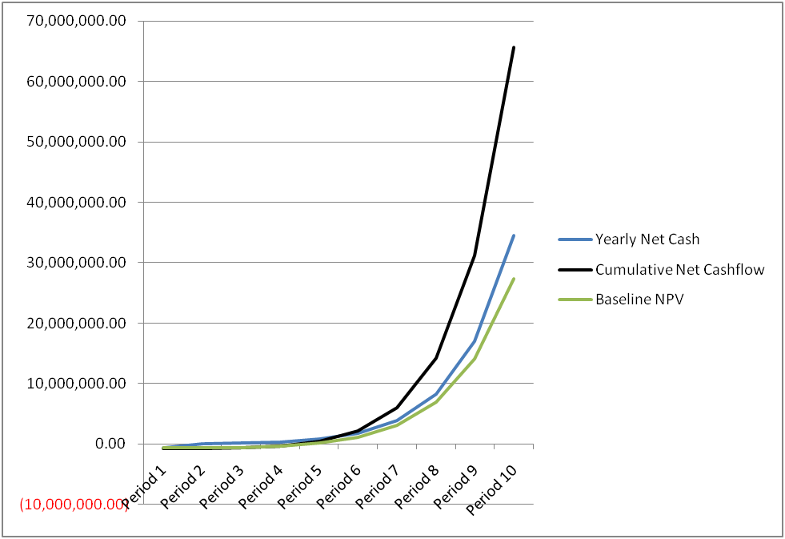
Cash Flow Analysis
Inputs / assumptions
Initial Demand | 5
Initial license sales* | 175000
*includes training fee | 0
*includes consulting fee | 0
 | Phase 1 | Phase 2 | Phase 3
License sales growth | 50% | 80% | 100%
R&D | 525000 | 100000 | 100000
Wages / salaries | 200000 | 300000 | 400000
Marketing costs | 80000 | 100000 | 150000
Payment processing fee | 4.5%
Discount rate | 10.0%
Notes:
[SLIDE 2] Cash Flow Analysis
The goal of the SSES team is to sell a complete system, -- license, consulting, and training -- for approximately $35,000. By comparison, a 20-user software license for Rockwell’s Arena simulation program (without on-site training) is reportedly valued at $270,000.
Our baseline assumptions for cost analyses are shown here. It will take about one year to complete the development activities of SSES. We expect to sell five systems the first year, which means our initial product sales will be $175,000. We anticipate that during phase 1, the first 3 years, we will have 50% growth. During Phase 2 and 3, we expect 80% and 100% growth respectively. Funds are allocated for additional R&D throughout all phases to retain a competitive advantage over other companies who may be late in arriving to the market.
This deterministic model yields a Net Present Value to be 27.4 million dollars. This figure is based on a 10-year period and was calculated by using DPL. After 10 years, we expect to sell 2319 systems. In year 3, we begin to see a positive profit. We expect to achieve the breakeven point between year 4 and 5.

Slide 16
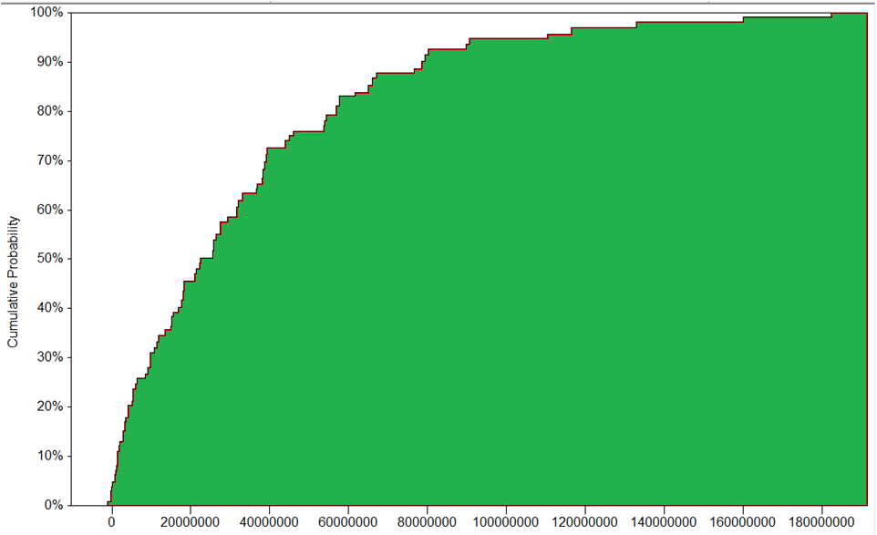
NPV Cumulative Probability Distribution
E[NPV] = 33,127,918
 | LOW | NOMINAL | HIGH
INITIAL SALES | 1 | 5 | 10
PHASE 1 GROWTH | 25% | 50% | 60%
PHASE 2 GROWTH | 50% | 80% | 100%
PHASE 3 GROWTH | 75% | 100% | 150%
Notes:
[SLIDE 3] Net Present Value Analysis.
However, initial sales and subsequent growth rates are uncertain. So we changed the deterministic model to a probabilistic one and created discrete chance nodes for these values. We then used DPL to calculate the expected value of the NPV using these discrete probability mass functions. We assigned probabilities of .3, .4, and .3 for the three chance outcomes. We also assumed the worst and best case scenarios for initial sales and subsequent growth for each phase, as shown here. Depending on the initial license sales and the growth of future license sales during all three phases of our project, the NPV has a large range of possible values. When we ran this through DPL, the worst-case scenario, with all variables coming up low, was a loss of $1.2 million dollars. The best-case scenario, with all variables coming up high, was 182.3 million dollars. Both of these outcomes have only a 0.81 percent chance of occurring. The expected value for all possible outcomes is 33.1 million dollars.
The cumulative probability distribution of the NPV is shown, along with the calculated expected value of the NPV. The probability of a negative NPV is approximately 2.5%. This risk is sufficiently small, and no further steps to mitigate risk are required at this time. Also, we ran a quick sensitivity analysis to determine which of these variables influence the NPV the most. NPV is most sensitive to initial sales, and so we will be aggressive in marketing the SSES in our first year.
I will now be followed by Joe, who will give a quick demonstration of the SSES.

Slide 17
SSES Prototype – Design and Capabilities
Design:
GUI driven design tool/environment
Based on network model data structures and algorithms
Capabilities:
Characterize and represent site topography
Select threats and objectives, calculate routes
Select and place sensors, calculate sensor coverage
Calculate intruder probability of detection, find and fix sensor coverage gaps and vulnerable routes
Estimate costs
Perform rapid design iterations

Slide 18
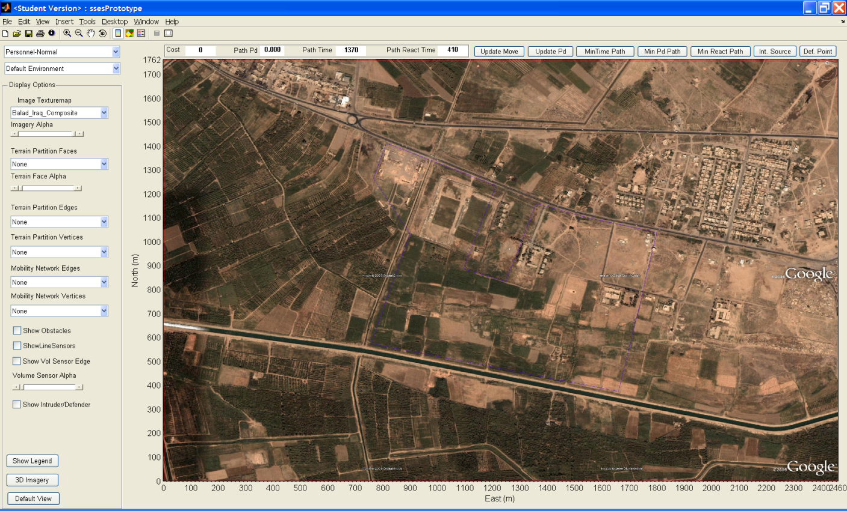
New SSES Project: Balad Camp

Slide 19
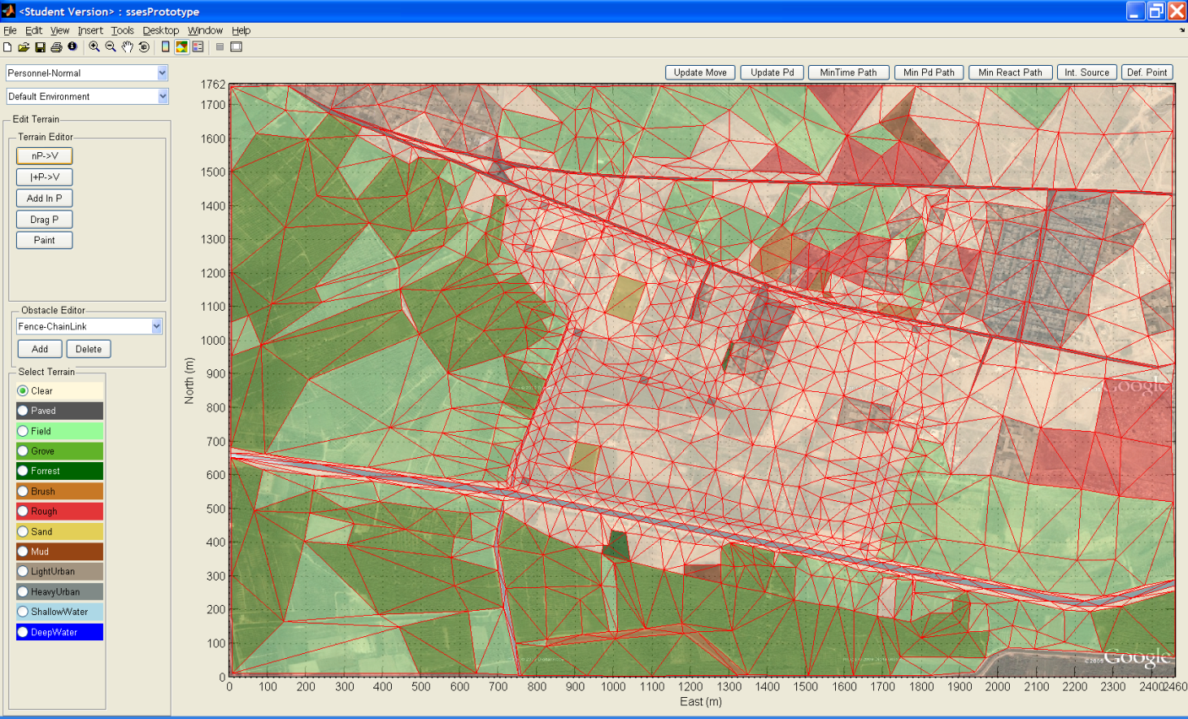
Terrain Network Model

Slide 20
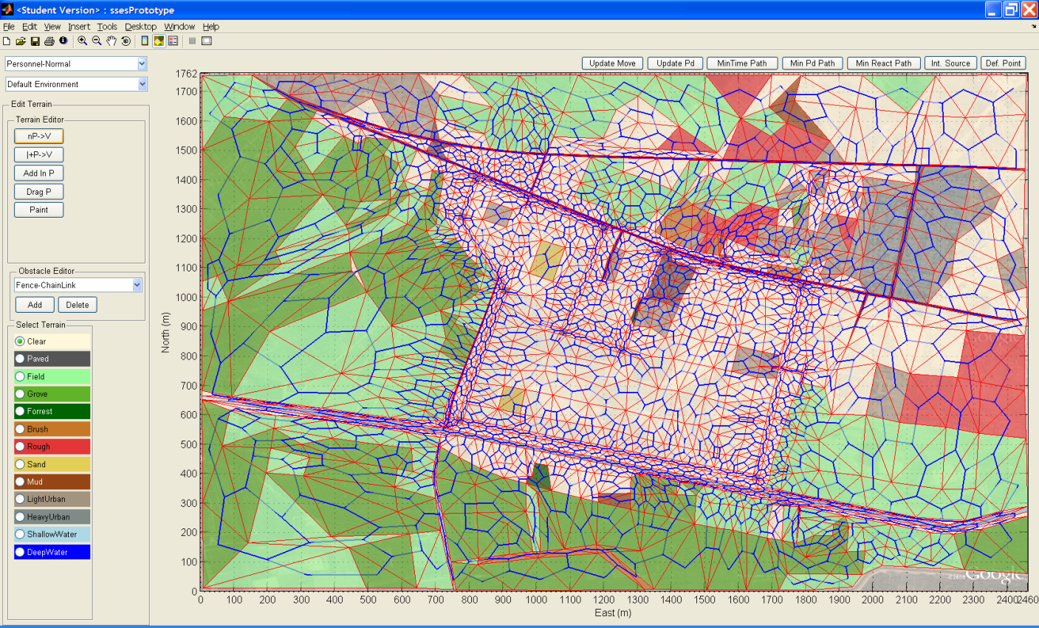
Mobility Network Model

Slide 21
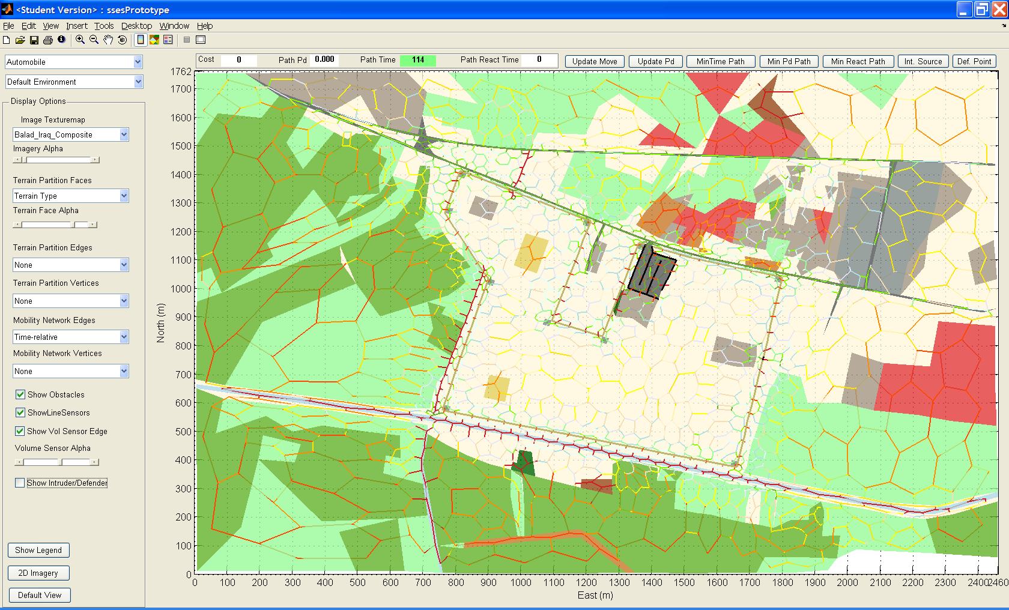
Mobility Network Cost - Vehicle

Slide 22
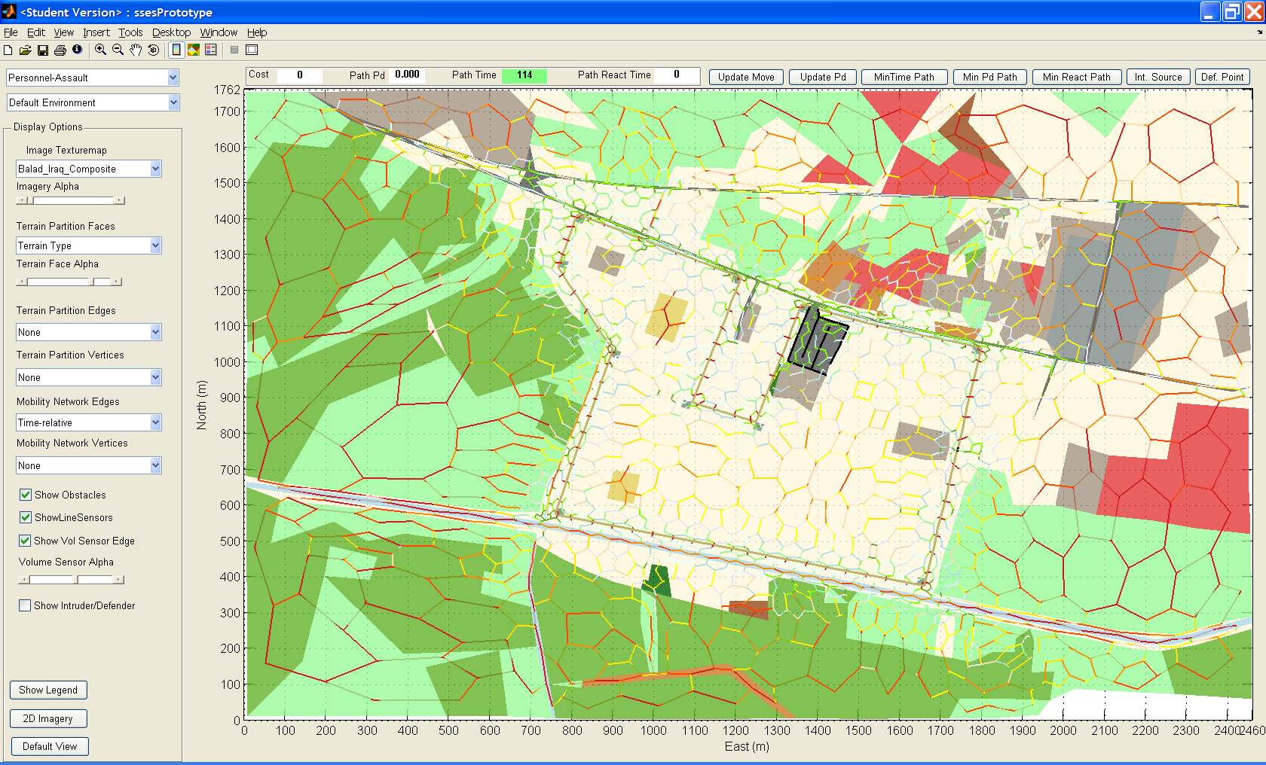
Mobility Network Cost - Personnel

Slide 23
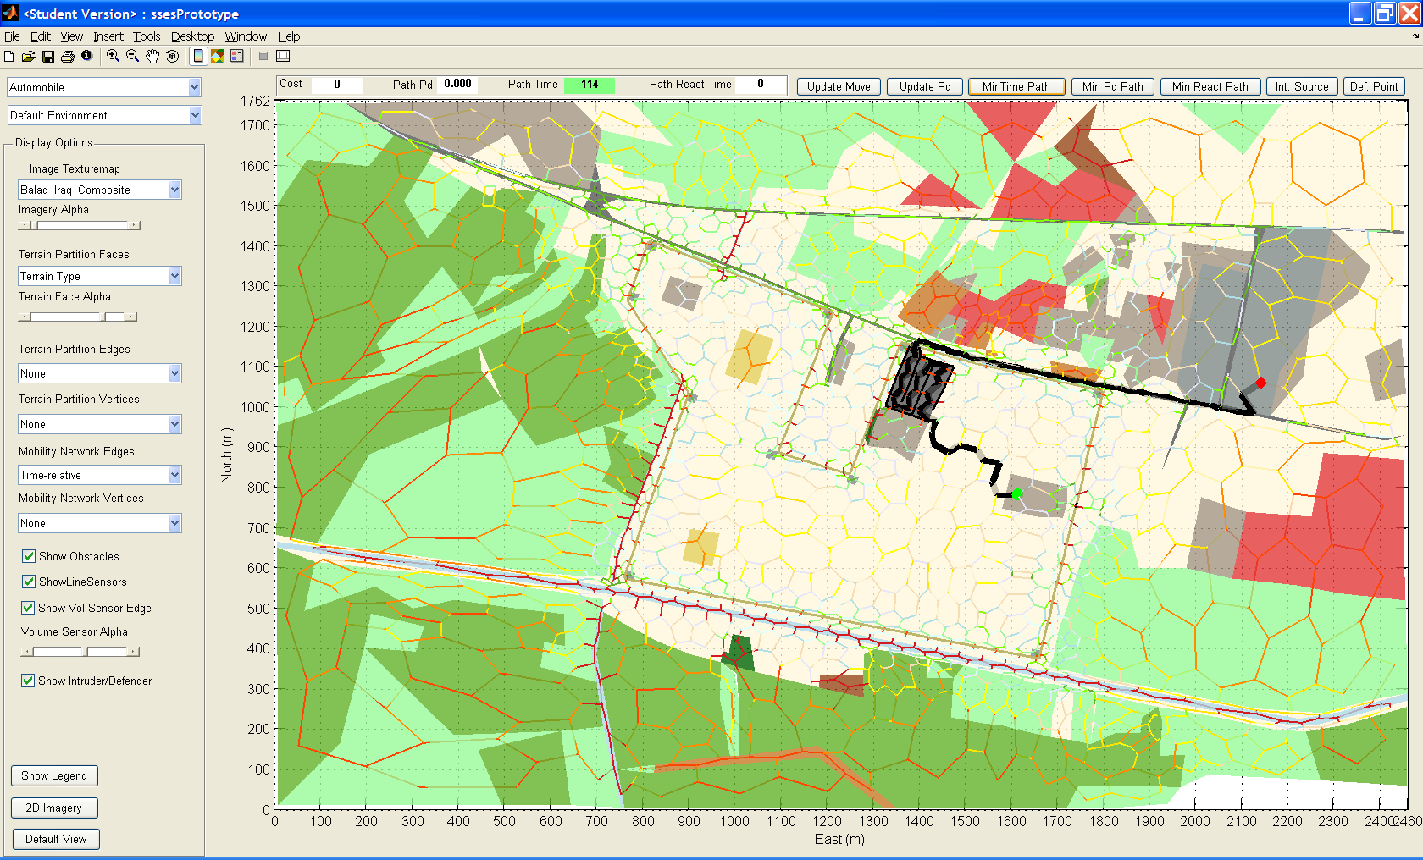
Intruder Quickest Ingress Path - Vehicle

Slide 24
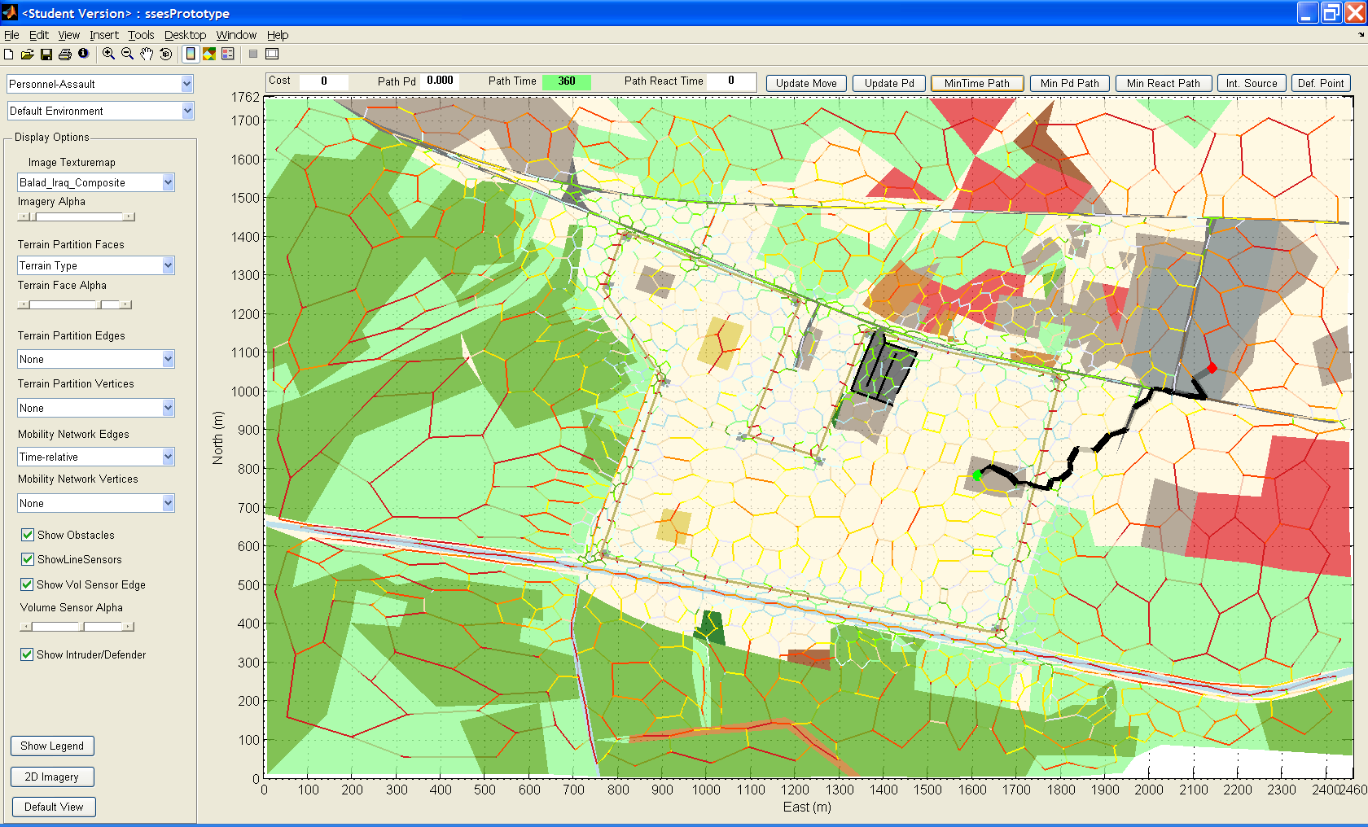
Intruder Quickest Ingress Path - Personnel

Slide 25
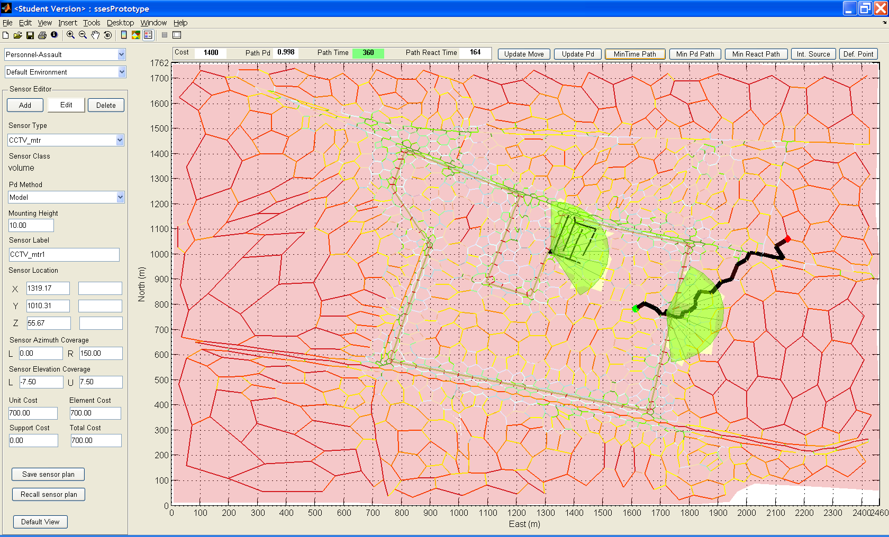
Simple Sensor Plan - 2 CCTV on Gates

Slide 26

Simple Sensor Plan

Slide 27
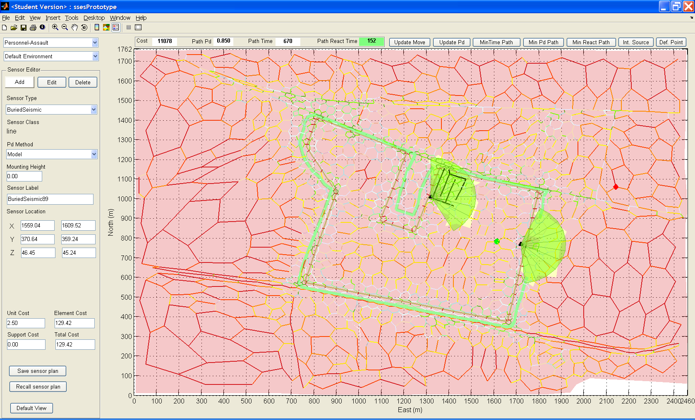
Improved Plan – Full Perimeter Coverage

Slide 28
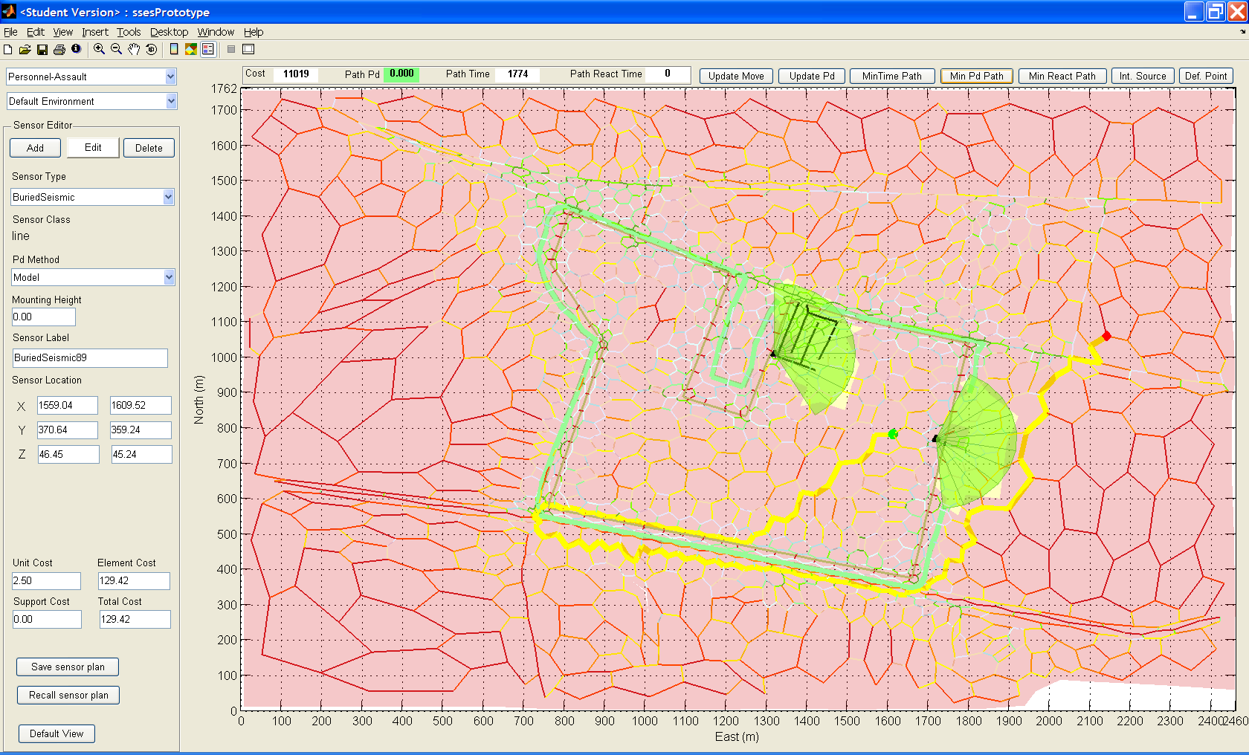
Actually (Almost) Full Perimeter

Slide 29
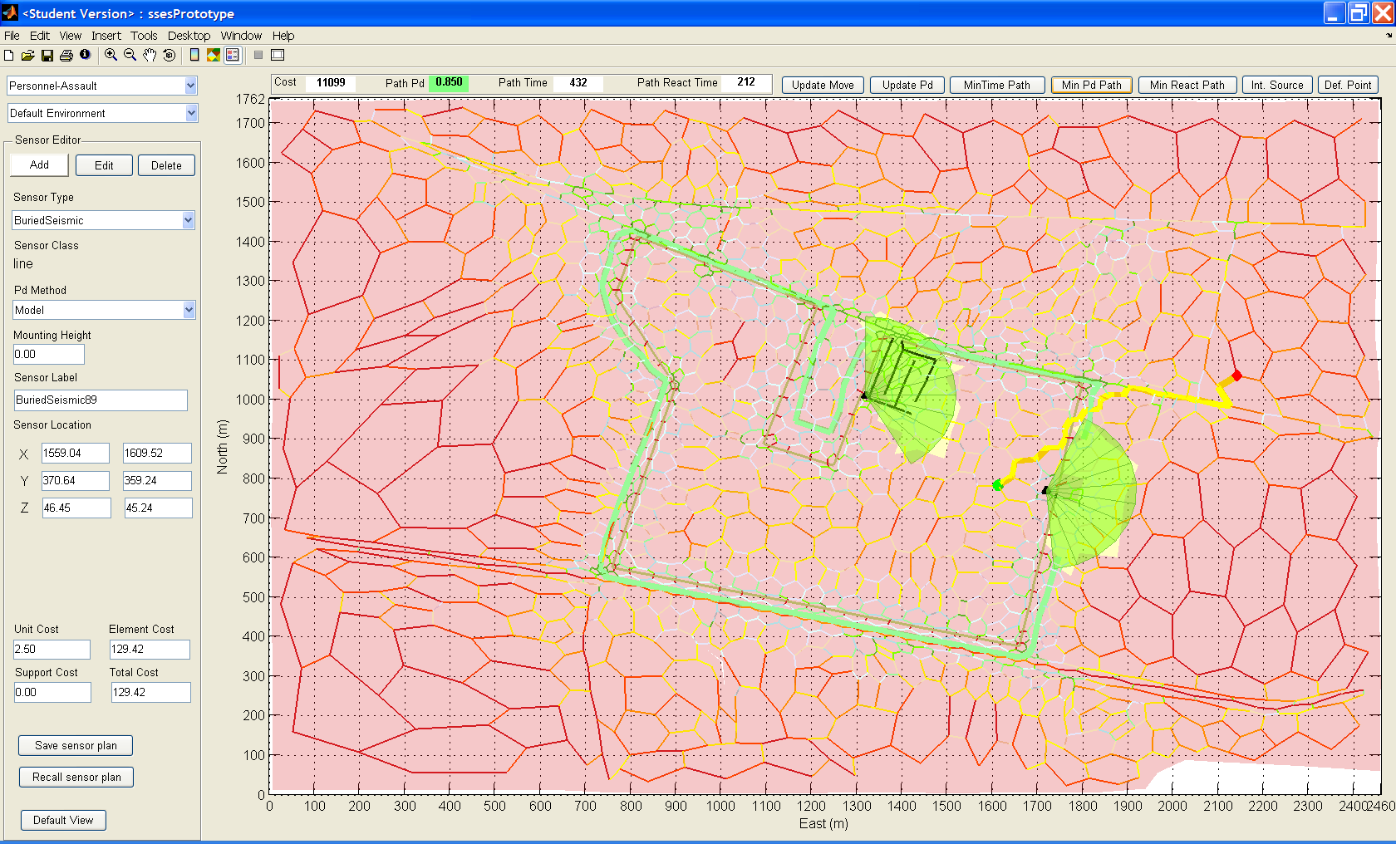
Corrected Plan With Gap Plugged

Slide 30
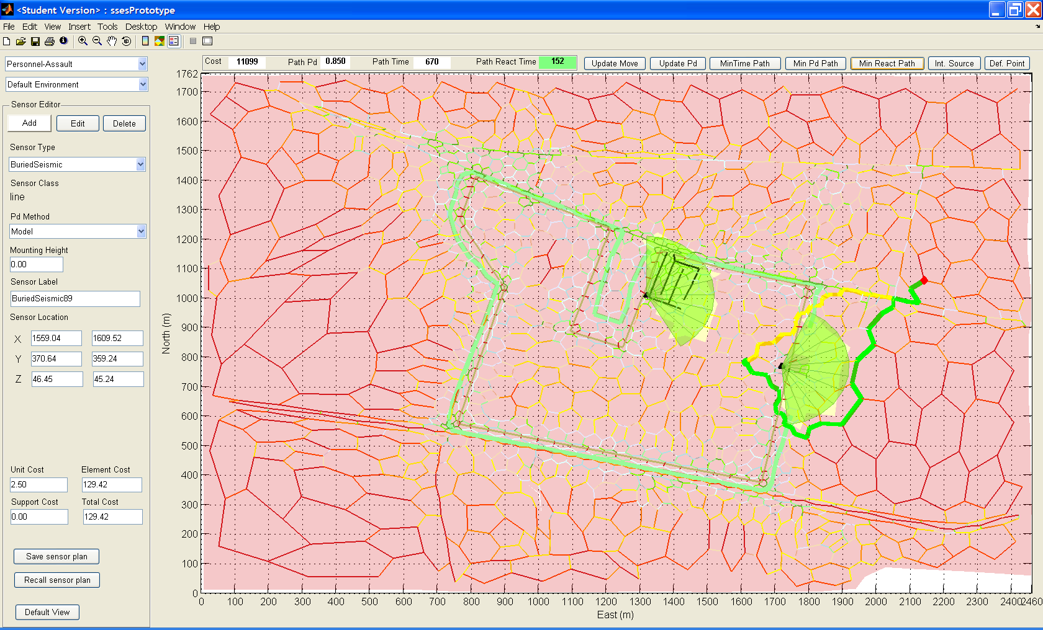
Min P_{d} vs. Min Reaction Time Routes

Slide 31
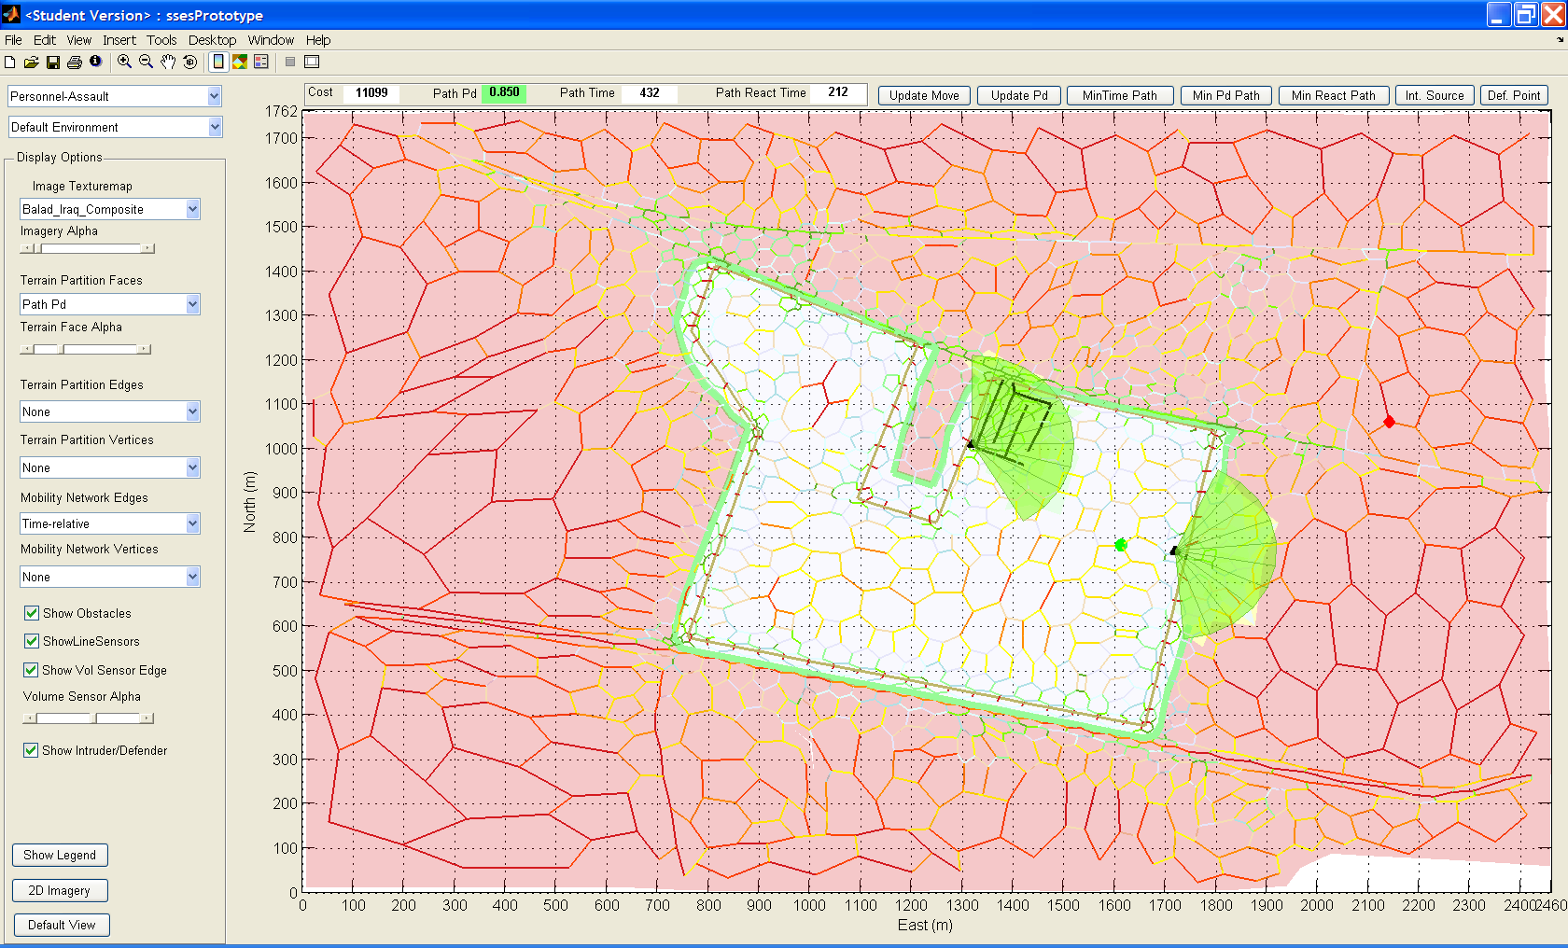
Path P_{d} Display Shows Defended Area

Slide 32
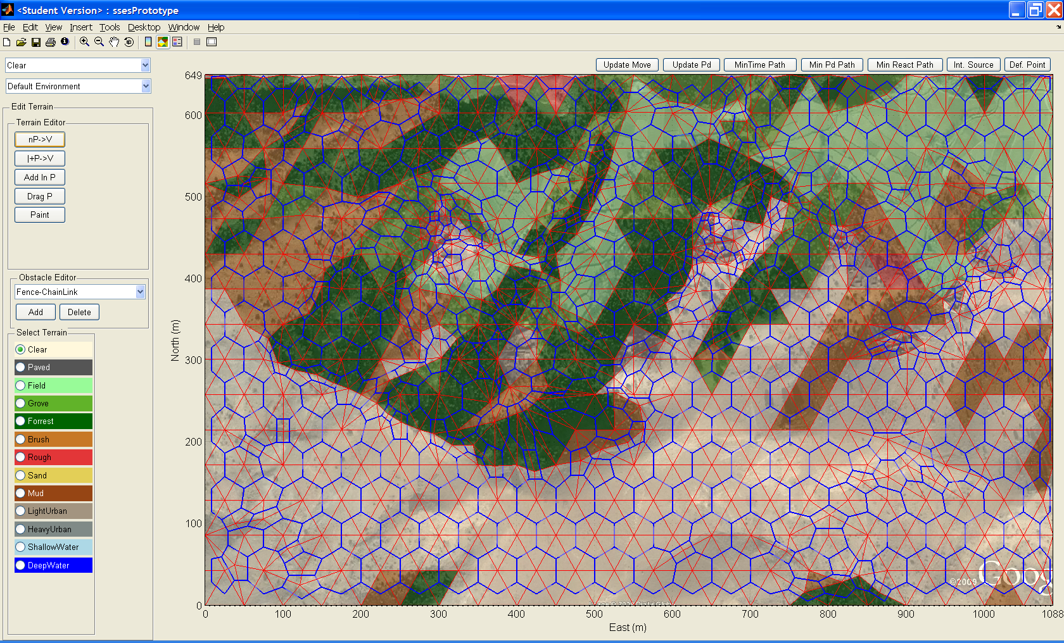
Afghanistan – Pakistan Border

Slide 33
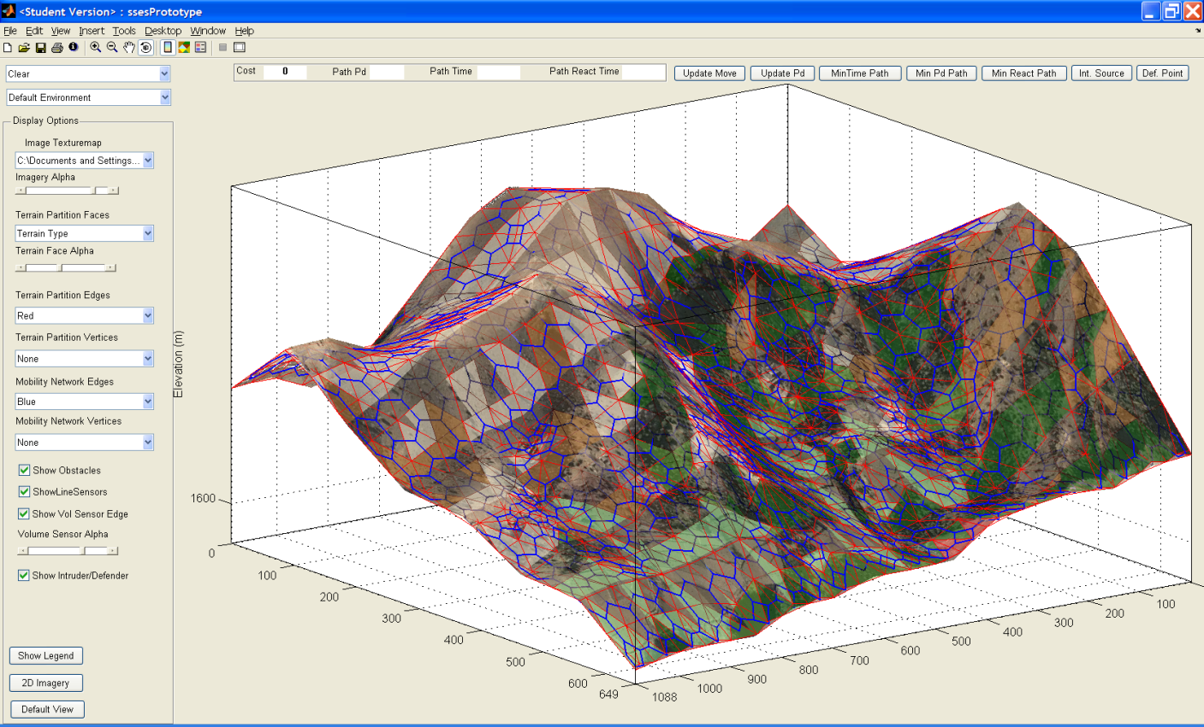
… Is Not Flat

Slide 34
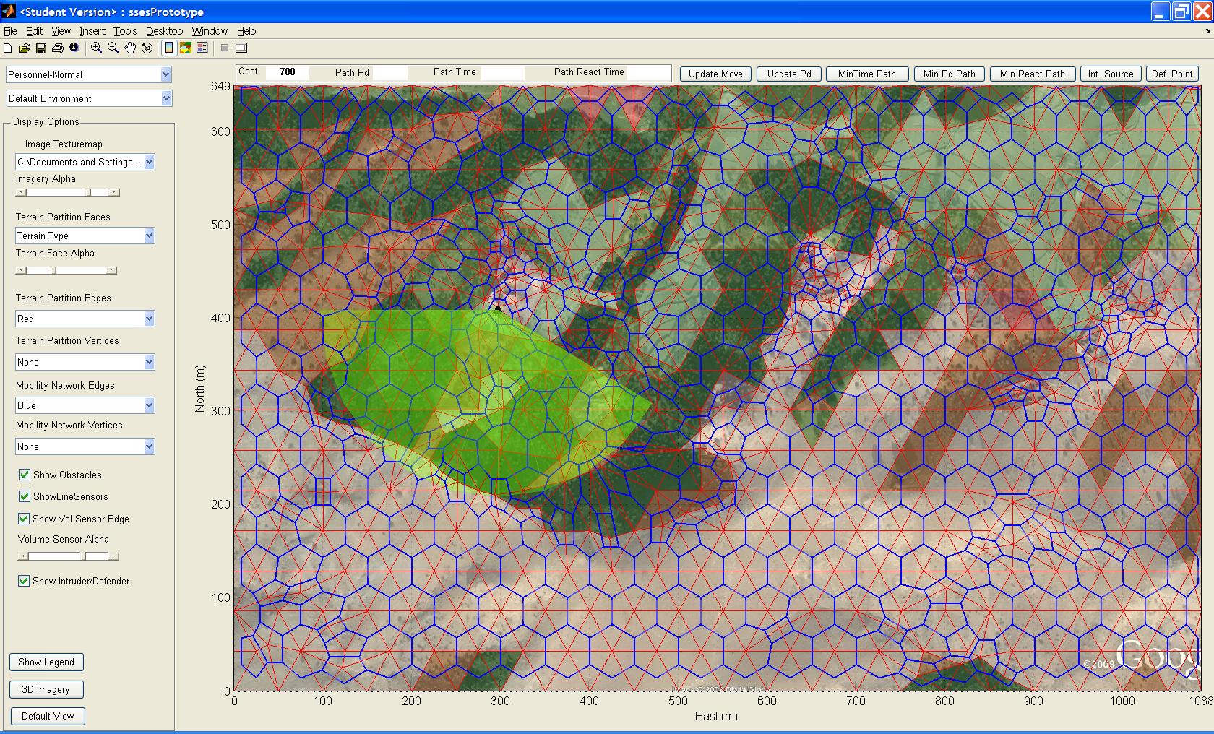
Expected Sensor Coverage

Slide 35
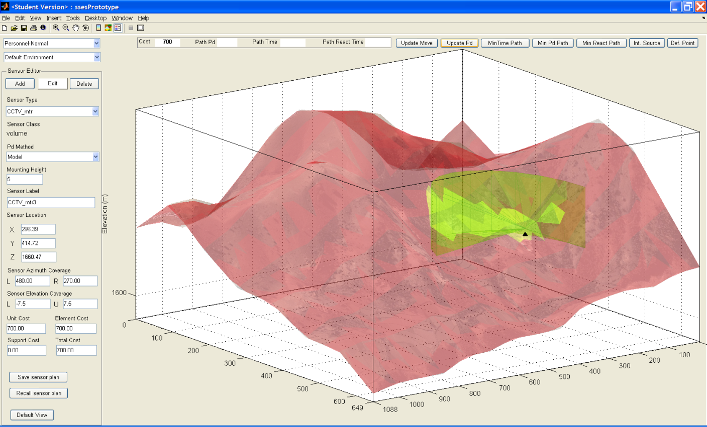
Expected Sensor Coverage … May Not Be Achieved

Slide 36
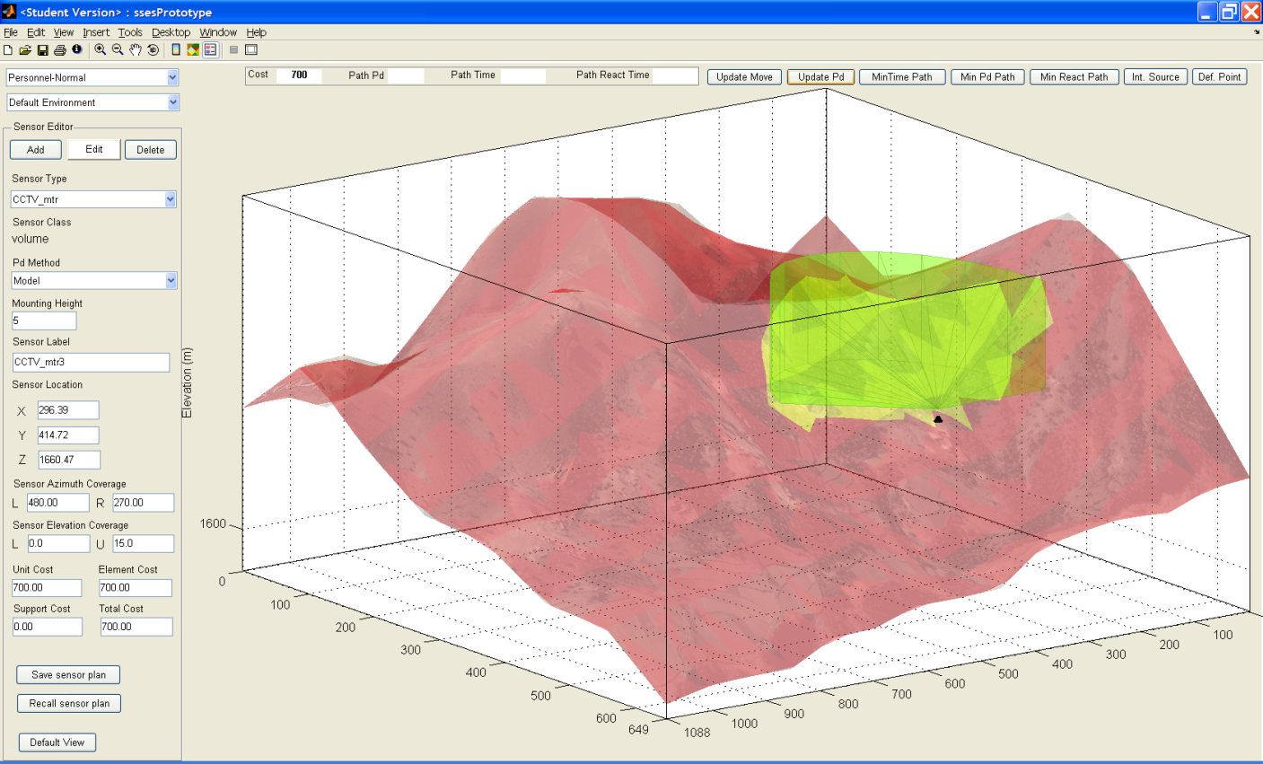
… Unless Topography Is Considered

Slide 37
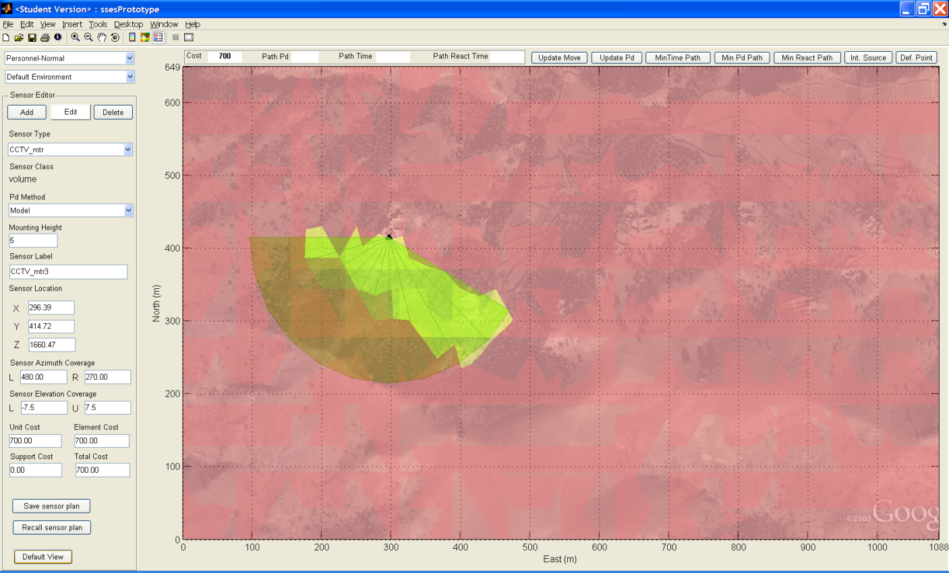
Naïve Sensor Orientation

Slide 38
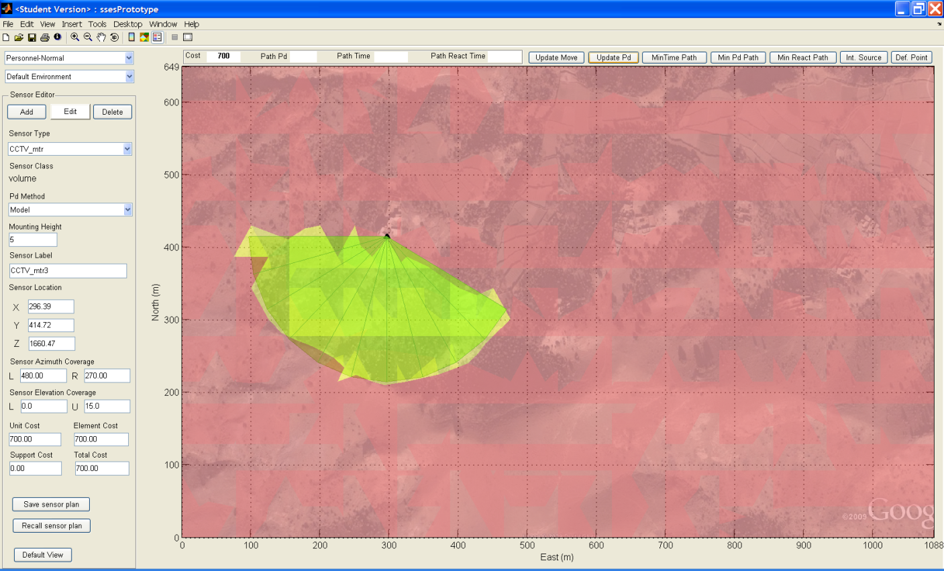
Sensor Oriented to Topagraphy

Slide 39
Summary
SSES concept works!
SSES improves ESS design performance and designer productivity
  Quantitative assessment of ESS performance
  Supports rapid iterative design process
  Find and fix security gaps and weaknesses
  Show relationship between cost and performance
Valuable addition to ESS design / assess toolkit – First-to-market opportunity
Architecture supports spiral capability growth

Slide 40
Notional SSES Product Evolution
Prototype
Funding + 9 months
V1.0
Funding + 20 months
V2.0
Heuristic sensor selection and placement
False alarm rate processing
Automated terrain network generation
Software aided design optimization
Interior sensors and “terrain”
Mobile sensors
Automatic site data gathering
Web based sensor specification retrieval
Optimization trade-off analysis
Automatic regional threat identification
Targeted capabilities and phasing are responsive to evolving stakeholder / sponsor needs
Notes:
V1.0 depends on obtaining development funding.
V1.0 capabilities and schedule can be adjusted to match sponsor objectives and available funding – adding sensor placement heuristics and modeling false alarm rates are top priorities.
V2.0 capabilities will likely be adjusted based on feedback as experience is gained with prototype and V1.0 systems. Incorporation of interior sensors and alarm systems to produce a fully integrated site security system is a top priority.
Selected V2.0 capabilities can be pulled forward into V1.x versions if funding is available.

Slide 41
Questions?

